Slide 1
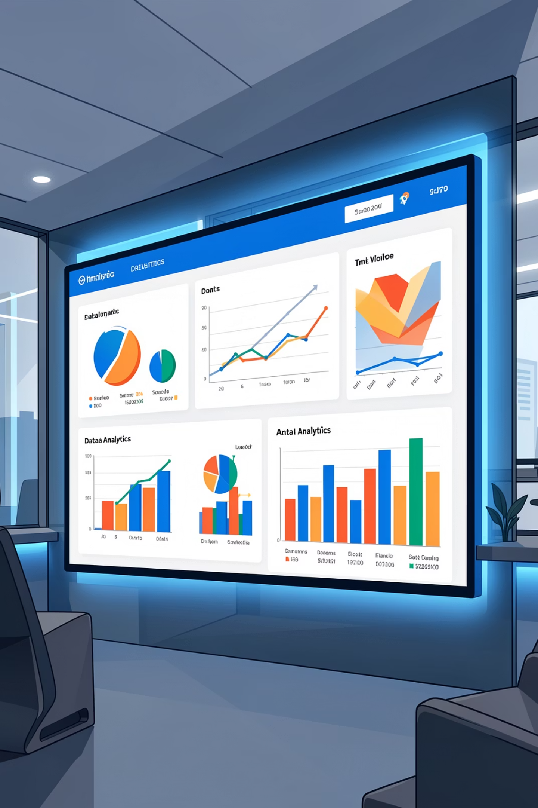
Customer Shopping Behavior Analysis
Uncovering insights from 3,900 purchases to guide strategic business decisions through data-driven analysis of spending patterns, customer segments, and product preferences.

Slide 2
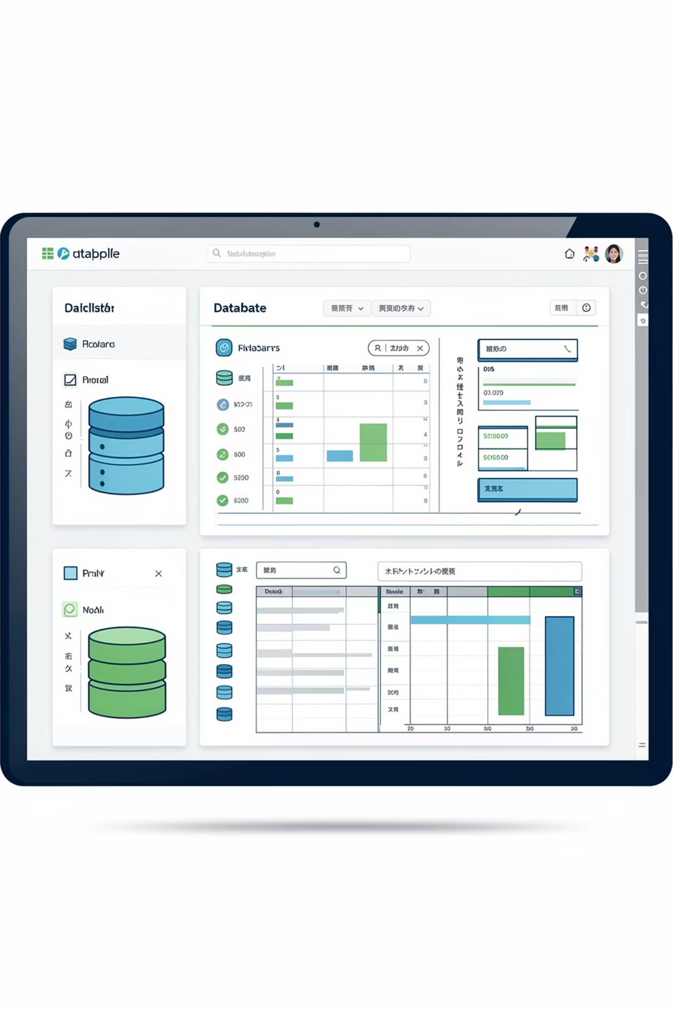
DATASET OVERVIEW
Understanding Our Data Foundation
3,900
18
50
Total Purchases
Data Features
Locations
Comprehensive transaction records analyzed
Demographics, purchases, and behavior metrics
Geographic diversity across customer base
Dataset includes customer demographics, purchase details, shopping behavior, and subscription status with minimal missing data.

Slide 3
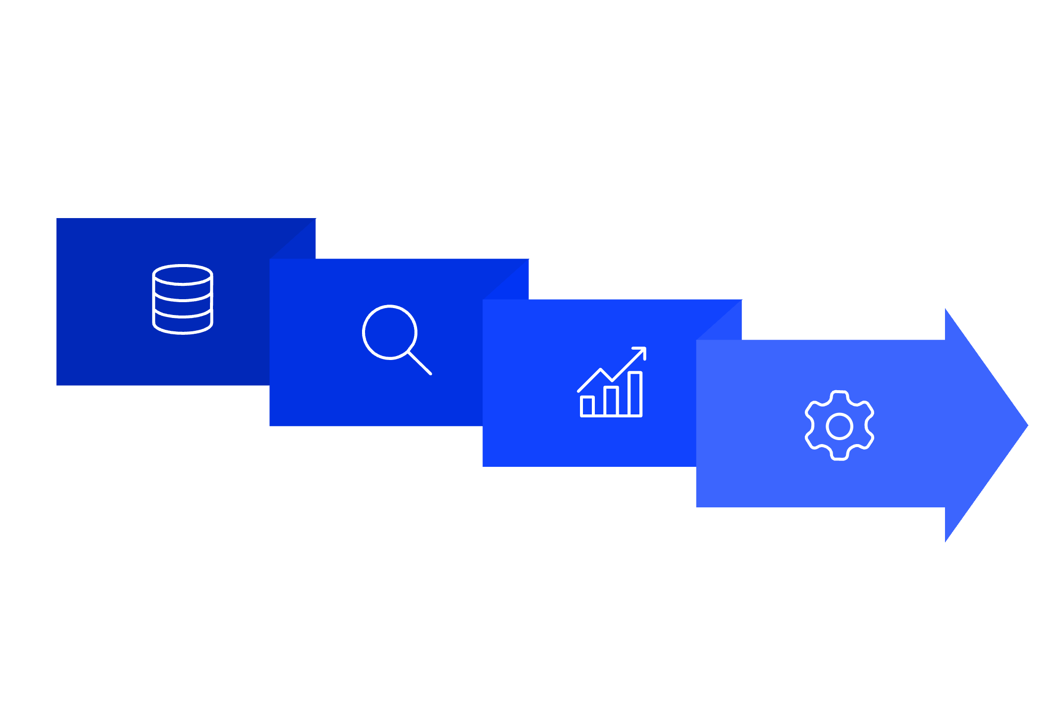




Data Preparation & Python Analysis
Data Cleaning
Explore & Clean
Imputed missing review ratings using category medians; standardized column names to snake_case.
Engineer Features
Feature Engineering
Created age_group bins and purchase_frequency_days for deeper segmentation analysis.
Load Data
Handle Missing
Database Integration
Connected to PostgreSQL for structured SQL queries and business intelligence.
Systematic approach ensured data quality and consistency for downstream analysis.

Slide 4
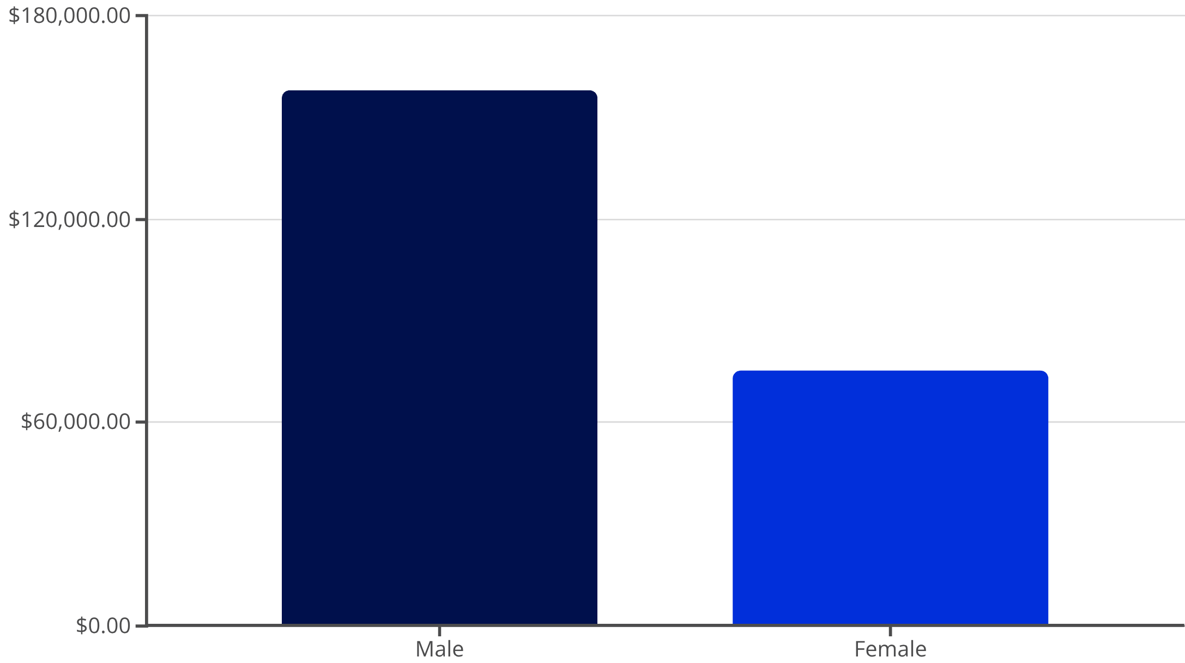
Revenue Insights by Gender
Male customers generate $157,890 in total revenue compared to $75,191 from female customers—more than double the contribution.
This significant gap suggests opportunities for targeted marketing campaigns to increase female customer engagement and spending.

Slide 5


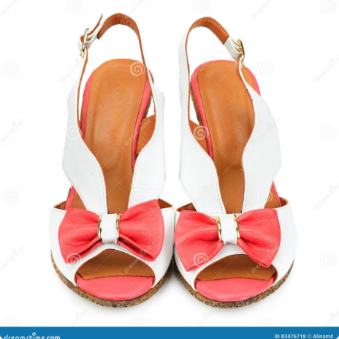



TOP PERFORMERS
Highest-Rated Products
Gloves
Sandals
Boots
Hat
3.86 average rating
3.84 average rating
3.82 average rating
3.80 average rating
Skirt
3.78 average rating
These top-rated products should be prominently featured in marketing campaigns and product recommendations to drive sales.

Slide 6
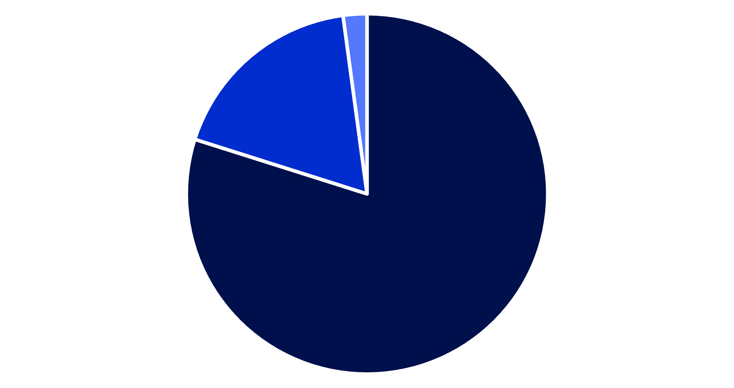
Customer Segmentation Analysis
Understanding customer loyalty patterns reveals opportunities for targeted retention strategies and personalized engagement.
Key Insight
80% of customers are loyal, demonstrating strong retention. Focus on converting the 18% returning segment into loyal customers through targeted loyalty programs and personalized incentives.
Loyal
Returning
New

Slide 7
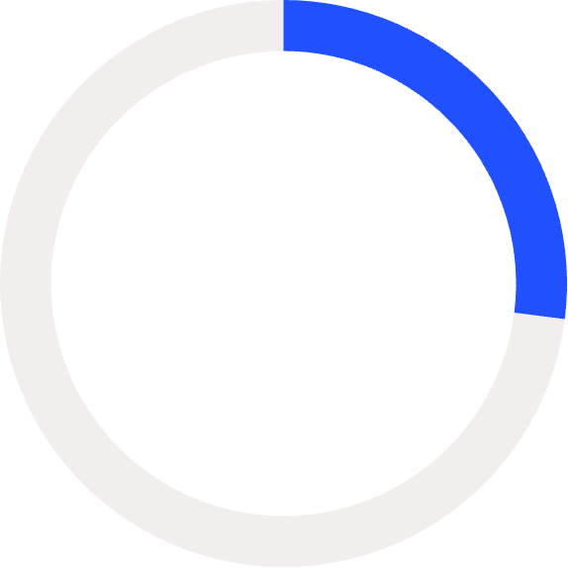


Subscription Status Impact
27%
73%
Subscribers
Non-Subscribers
1,053 customers with subscriptions
2,847 customers without subscriptions
Revenue Comparison
Subscribers: $62,645 total revenue ($59.49 avg spend)
Non-Subscribers: $170,436 total revenue ($59.87 avg spend)
Despite similar average spending, the large non-subscriber base represents significant untapped potential for subscription growth.

Slide 8
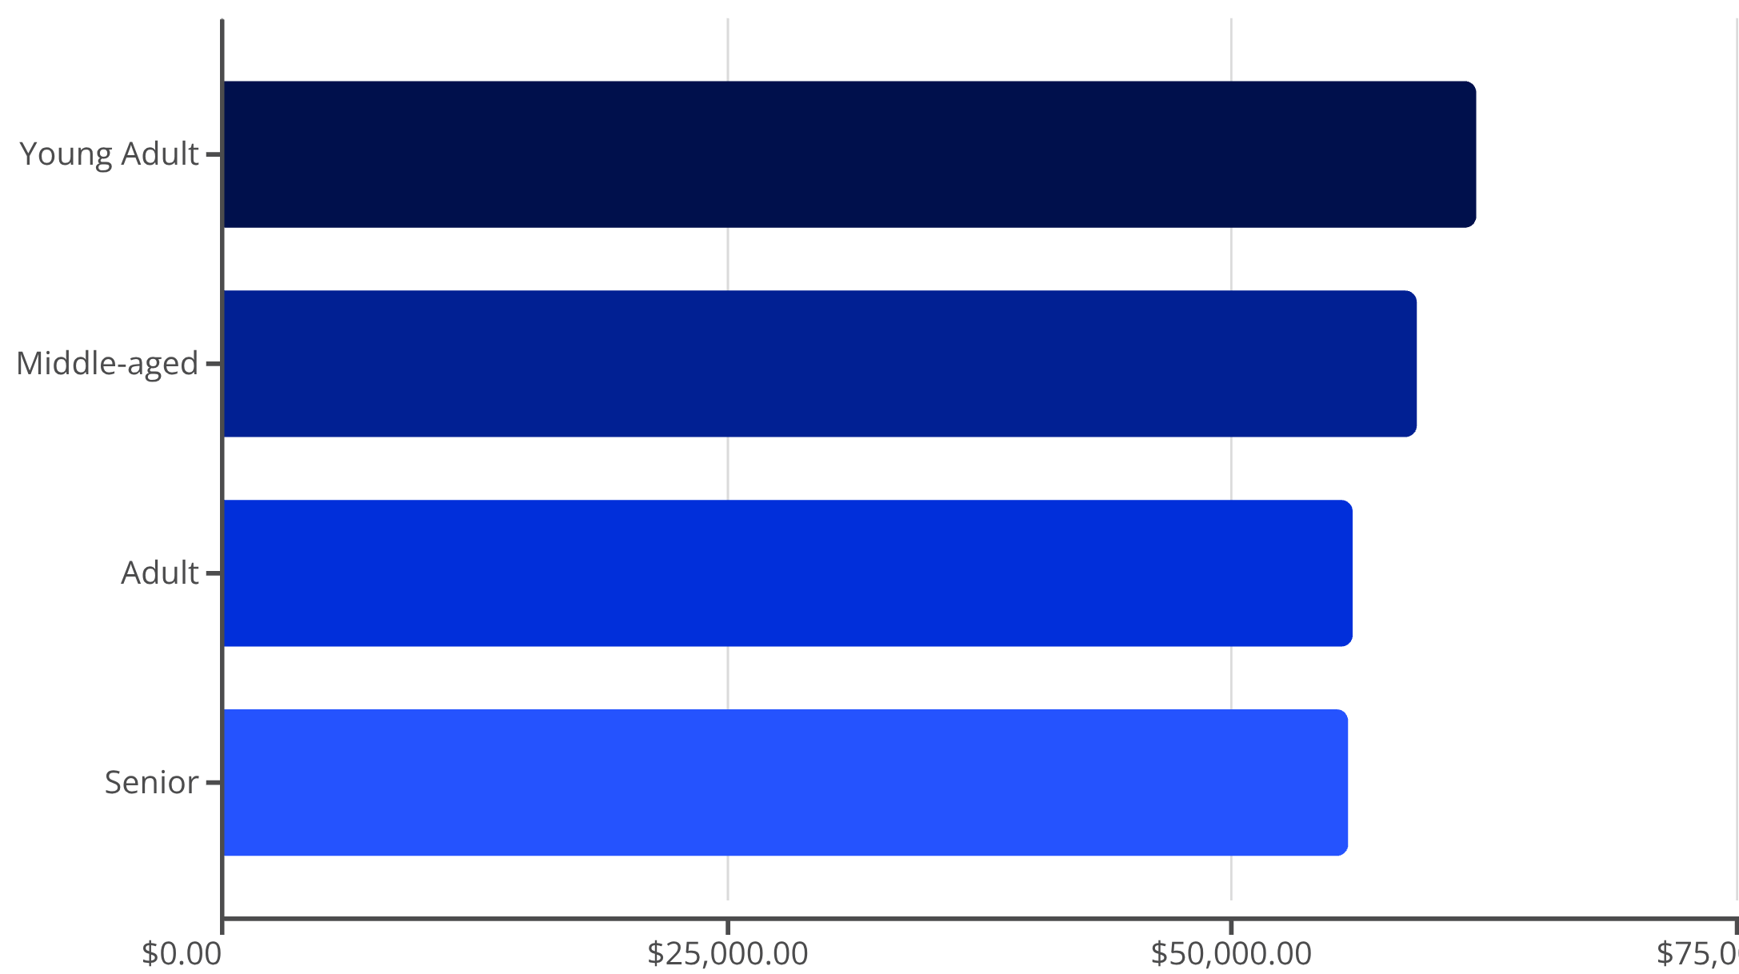
Revenue by Age Demographics
Demographic Insights
Young adults lead revenue generation at $62,143, followed closely by middle-aged customers at $59,197.
Revenue distribution is relatively balanced across age groups, suggesting broad market appeal. Tailor marketing messages to resonate with each demographic's unique preferences and shopping behaviors.

Slide 9


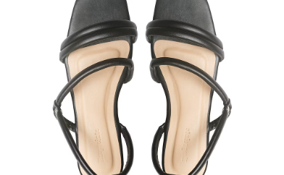
CATEGORY PERFORMANCE
Top Products by Category
Accessories Leader
Clothing Champion
Footwear Favorite
Jewelry tops accessories with 171 orders, followed by sunglasses and belts at 161 orders each.
Blouse leads clothing category with 171 orders, with pants and shirts close behind at 171 and 169 orders.
Sandals dominate footwear with 160 orders, followed by shoes (150) and sneakers (145).

Slide 10





Strategic Recommendations
Boost Subscriptions
Loyalty Programs
Review Discounts
Promote exclusive benefits to convert the 73% non-subscriber base into recurring revenue.
Reward repeat buyers to move returning customers into the loyal segment.
Balance promotional sales with margin control—839 customers spent above average despite discounts.
Highlight Top Products
Targeted Marketing
Feature highest-rated items like gloves and sandals in marketing campaigns.
Focus on high-revenue demographics: young adults and express-shipping users.

